Slide 1
Glory Tabernacle Ministries International
The School Of Evangelism
www.gloryrtabernacleministries.com

Slide 2
“Study to Show Thyself Approved
Unto God”
2 Tim 2:18

Slide 3
About us
This Ministry of Glory Tabernacle started by the leading of the Holy Spirit. It is a Ministry of Restoration to both Individuals, families & Churches. The Lord has given us His word as a foundation scripture upon which this vision is carried out .
“The glory of this present house will be greater than the glory of the former house,' says the LORD Almighty”. Haggai 2:9
He who has promised will surely continue to be faithful to the very end. and as it is written
"In that day I will restore David's fallen tent. I will repair its broken places, restore its ruins, and build it as it used to be” Amos 9:11
The Ministry of Glory Tabernacle is a Full Gospel in its teaching, Evangelical in Approach and charismatic in Function.
To Him be the Glory forever. Amen

Slide 4
Our strategy
We use tailor made training programme for the local challenges
We use local support network and pastoral oversight for the groups
We use Local Missionaries to reach the local needs of the mission field

Slide 5
Our mechanism
Motivation – Don’t give up
Encouragement – Reach the goal
Prayer – CHANGES ALL THINGS

Slide 6
THE TARGETED OUT COME
out reach method from Inside to the out side
THE UTTERMOST
SAMARIA
JUDEA
JERUSALEM

Slide 7
The School of Evangelism
This is our training programme that fits to suite all and it has proved to be very effective
way of teaching & engaging in Practical mission. This diagram shows us that between each training there is a 3 moths of field work In candidates respective mission field .
During these time they are given needed resources , pastoral oversight , and financial support.
Meeting
Centre
2nd Training May
3rd Training September
1st Training January

Slide 8
TEACHING OVERVIEW
WORKSHOP
VISION
COMMISSION
MISSION
The main focus of this programme is to remind one self that we are
called to be the Fishers of men and appointed
by the LORD to be His representative. This workshop’s
Mission objectives are ENVISION, ENDOSS & EMPOWER

Slide 9
This model of training and tactical approach to the need of the
ministers & ministries has yielded a great result and many native or local missionaries have come out of their limitations to discover their potential.
With over whelming amount of Christian persecution all across the land Inter state missionaries have been restricted to do the mission work effectively, Hence School of Evangelism is a great programme & tool to enhance the work of the harvest locally.
Dear Partners
Therefore let us Strengthen the task force, stand in the gap & pray to the Lord of the harvest , support the work and be a part of this mission family.
God Bless You
www.glorytabernacleministries.com
Contact revnjr@yahoo.co.uk

Slide 10
Facts of the mission field
India’s population 1.22 billion
The population of Karnataka is further divided into different religions
originating in the state.
Hindus 83.9%
Muslim 12.2%
Christian 4 %
Jains 0.78%
Buddhist 0.73%
Current Population of Karnataka in 2012 is 70,201,204

Slide 11
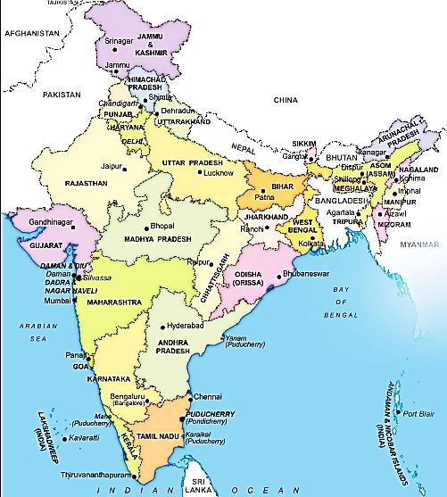
India
India’s population as of 2012.
1.22 billion
The population of Karnataka is further divided
Into different religions originating in the state.
Hinduism is the dominant religion with
83.9% of the population are Hindu's,
12.2% are Muslim,
4% are Christian,
0.78% are Jains,
0.73% are Buddhist,
Sikhs 0.03%. Population of Karnataka in 2012
70,201,204
Literacy rate 75.4 %

Slide 12
Karnataka State is known as the wilderness for the Gospel, It has been a constant spiritual battle for the mission work in this region, countless Christian organisations are working in Karnataka to see the breakthrough for revival but often it ends up with persecution and jail.
In recent years of India - Karnataka in particular has attracted the world wide criticism for the atrocities committed against Christians & ministries. Many have lost their hope and even given up their faith in Jesus Christ.
Take a look at this video clip from SKY NEWS and other sources
http://www.youtube.com/watch?feature=player_detailpage&v=0s8-FB_yk20

Slide 13
The Glory Tabernacle Ministries is a registered Charity in India
Under the name of Glory Tabernacle Charitable Trust. Regd
For more detail please contact:
Rev. J. Noble
Rev. Jayraj Nathan
www.glorytabernacleministries.com
revnjr@yahoo.co.uk

